Slide 1
Recent Emphasized Prioritized Experience Replay base on Deep Q-Network
Group member: 刘浩新 陈卓

Slide 2
Content
Introduction
Related work
Our model
Experiment
Future work

Slide 3
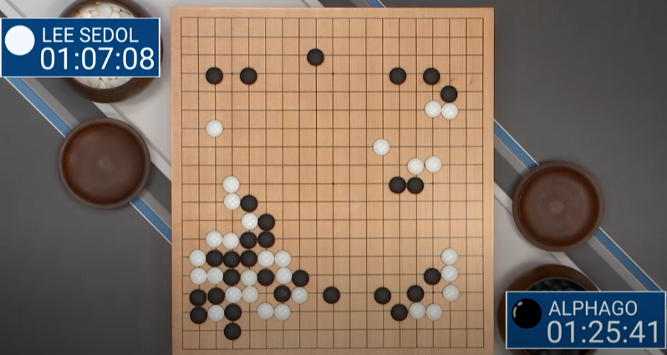
Introduction
Motivation：
AlphaGo:
Combination of neural network
and reinforcement learning
Overview:
DQN
Memory buffer
Sample
Priority
Loss value
Degree of recentness

Slide 4
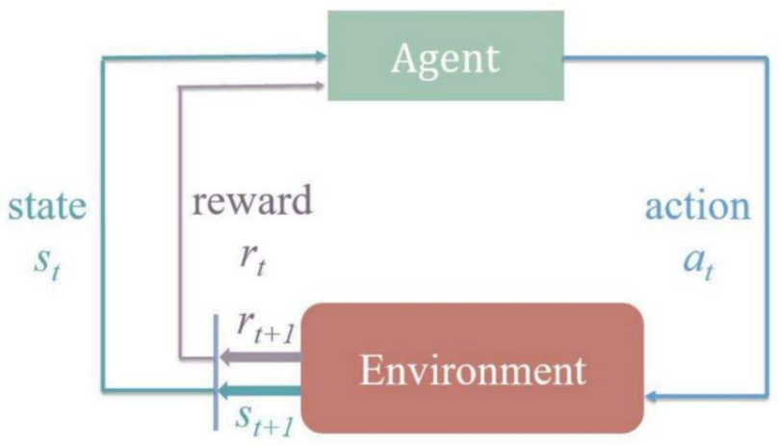
Related work
Reinforcement
learning
Deep Q-Network
(DQN)
Prioritized Experience
Replay (PER)
DQN
(first model in DRL)
convolutional neural network
Experience replay buffer (same weight)
a variant of Q-learning
Assign priorities to different samples

Slide 5
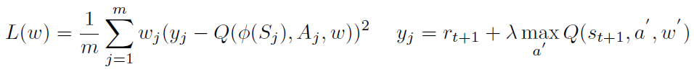
Our model
Two
sub-network
Target
Q-Net
Simulate actual Q-value
Predict
Q-Net
Predict current Q-value
Network Architecture:
(Nature DQN)
Basic criteria for priority calculation:
Loss function:
predict Q-value
calculated in predict Q-net
target Q-value
calculated in target Q-net

Slide 6
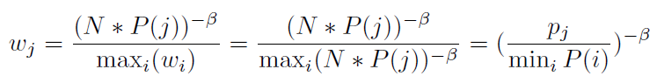
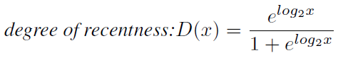
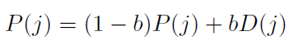
Our model
Basic criteria for priority calculation:
Priority weight of the j-th sample
and it is computed by TD error normalization
We will re-calculate the TD-error of all samples
and then update all samples’ priority in each step.
Quantification of degree of recentness:
Transform function round this time
number to a properly ranged logit
Also, we set a hyper-parameter balancing b
which balances the weight of priority based
on TD error and the degree of recentness.

Slide 7
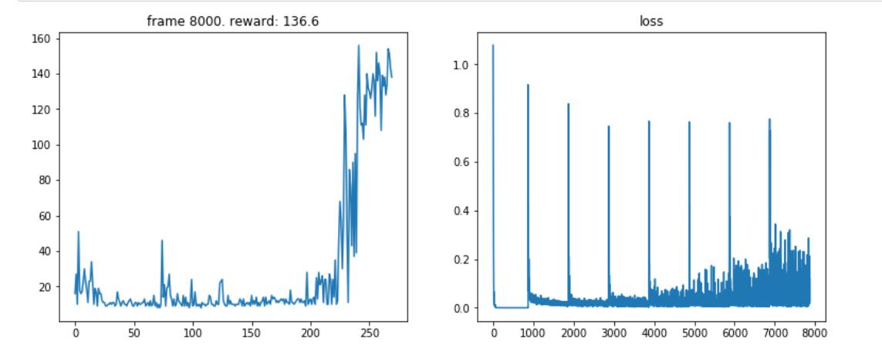
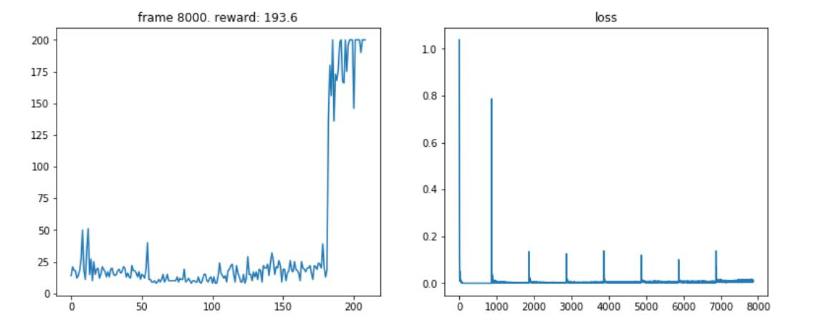
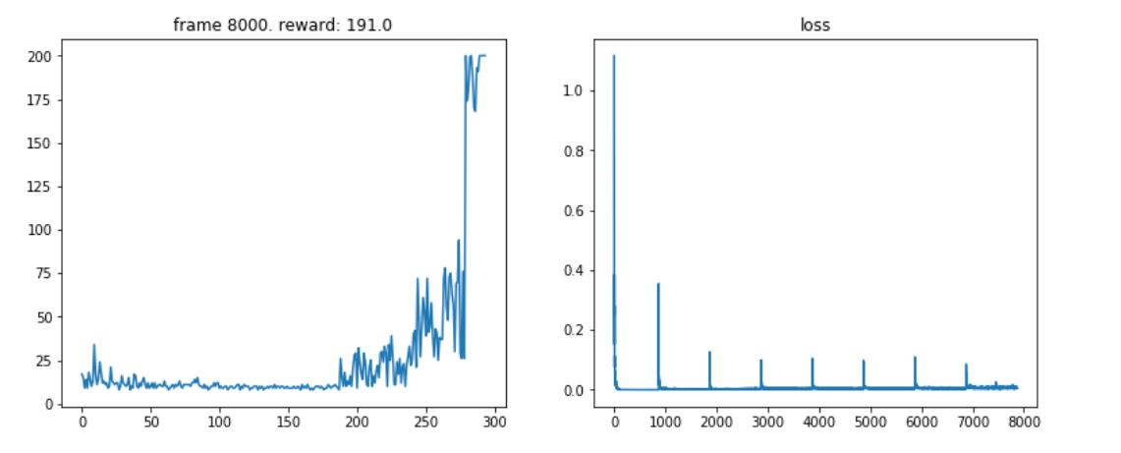
Experiment
Cart Pole Game
Random sampler
Need >= 300 rounds to master
Reward is low within 300 rounds training
REPER sampler
Master fast
Only need about 180 rounds to master
Reward is the highest
Simple prioritized sampler
Need about 280 rounds to master
Reward is fair only when there are >= 280 rounds

Slide 8
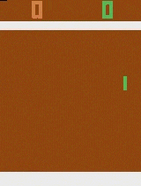
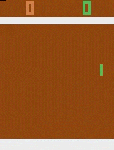
Experiment
Pong Game
--Harder, more complicated network
After 600 rounds of training, REPER can easily defeat the opponent, while the Random sampler struggles.
Random Sampler
REPER Sampler

Slide 9
Future work
1
Reduce the number of parameters in our model
2
More intelligent methods to evict memory entry, i.e. how to evict the less useful ones
3
Combine more ways to sampling in different situations.

Slide 10
Thank you for your listening!
Reporter: 刘浩新 陈卓

